Slide 1






4-Week Plan
Mark
Cosmin
Mart
Clemens
01.03.2021

Slide 2
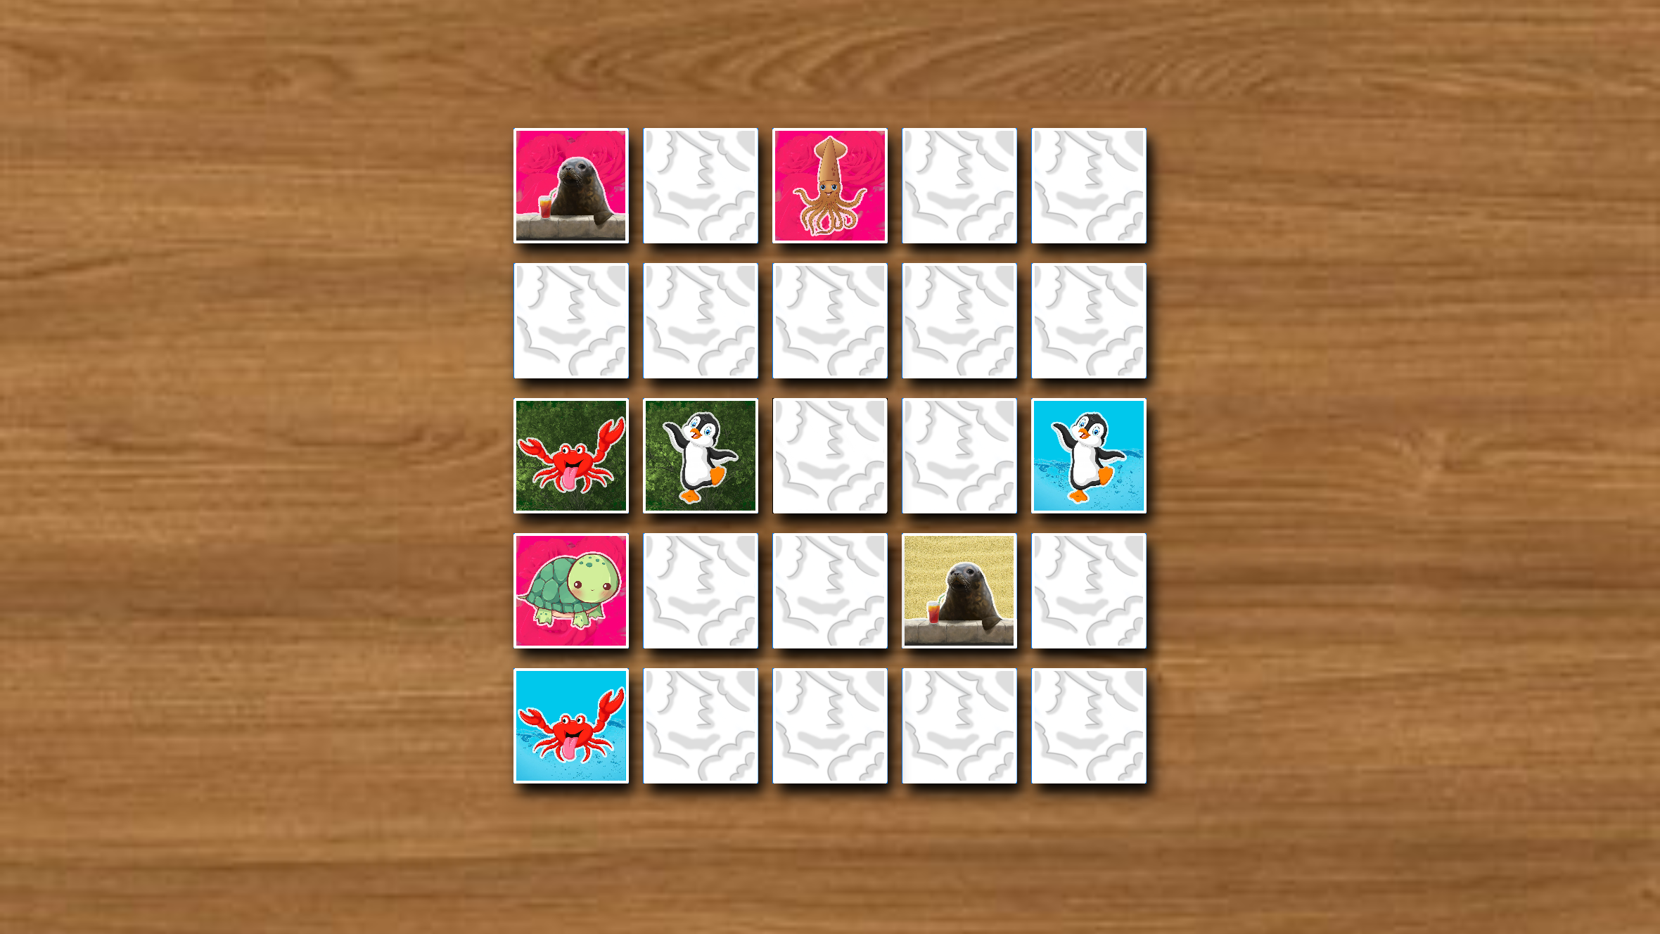
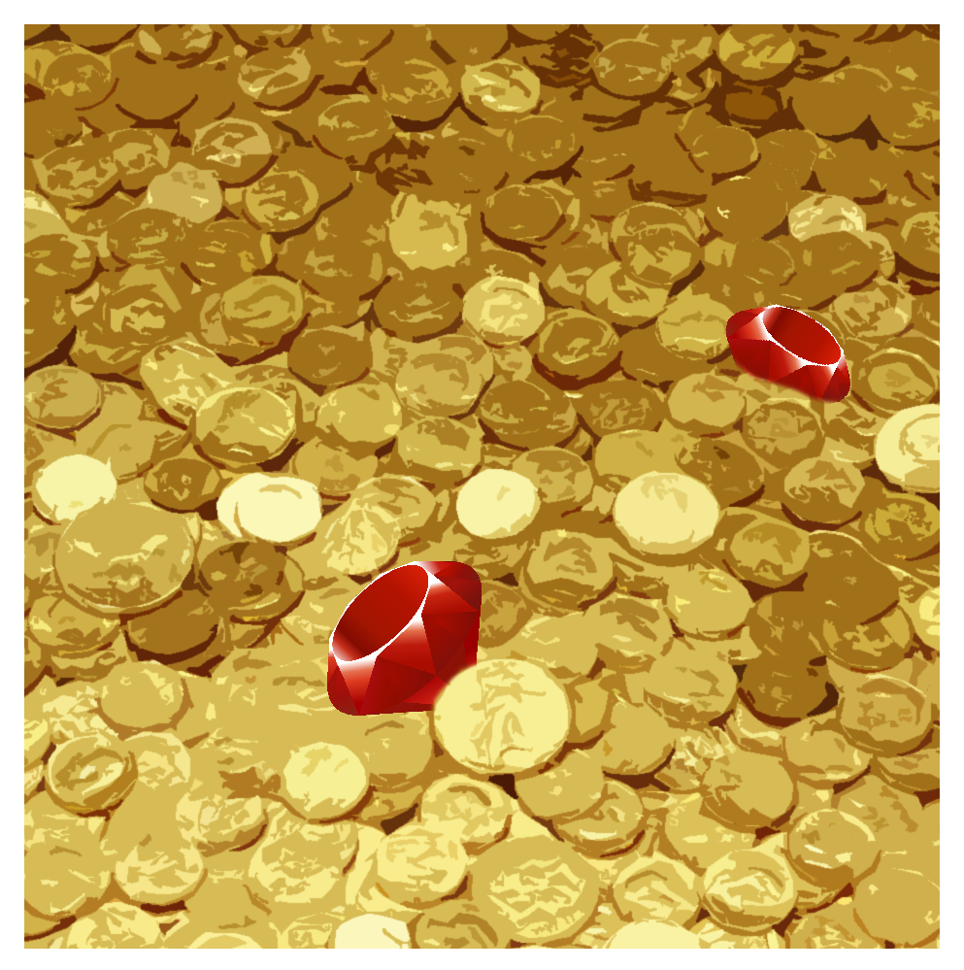


Slide 3
# | Task | Duration | Start | ETA | Week 1 |  |  |  |  | Week 2 |  |  |  |  | Week 3 |  |  |  |  | Week 4 |  |  |  |  | Week 5
 |  |  |  |  | M | T | W | T | F | M | T | W | T | F | M | T | W | T | F | M | T | W | T | F | M | T | W | T | F
1 | Create first ACT-R | 1 week | 01.03.21 | 05.03.21
2 | Create Report Outline | 1 week | 01.03.21 | 05.03.21
3 | Finalize game UI | 2 weeks | 01.03.21 | 12.03.21
4 | Finalize game logic | 2.5 weeks | 01.03.21 | 17.03.21
5 | Create human-like act-r | 1.5 weeks | 08.03.21 | 17.03.21
6 | Write first draft report | 2 weeks | 08.03.21 | 19.03.21
7 | Check model validity | 1 week | 15.03.21 | 19.03.21
8 | Create other views | 1 week | 15.03.21 | 19.03.21
9 | User evaluation | 0.5 weeks | 22.03.21 | 24.03.21
10 | Finalize report | 1 week | 22.03.21 | 26.03.21
11 | Integration of feedback | 0.5 weeks | 24.03.21 | 26.03.21
12 | Create Presentation | 0.5 weeks | 29.03.21 | 31.03.21

Slide 4
What we got so far…
Game
Model
Report & Presentation
Draft of UI
Parts of the game logic
–
–

Slide 5

Week 1 (01.03. - 07.03.)
Game
Model
Report & Presentation
Continue game logic implementation
Add missing UI elements
Integrate model with the game
Create first simple ACT-R model
Integrate model with the game
Create report outline

Slide 6
Week 2 (08.03. - 14.03.)
Game
Model
Report & Presentation
Continue game logic implementation
Adapt UI element designs (if necessary)
Create first ‘human-like’ ACT-R model
Start with first report draft

Slide 7
Week 3 (15.03. - 21.03.)
Game
Model
Report & Presentation
Finalize game logic implementation
Create other views (Menu, settings, help, results)
Finalize ACT-R model
Check validity of model
Finish first draft report

Slide 8
Week 4 (22.03. - 28.03.)
Game & Model
Report & Presentation
User evaluation
Integration of feedback
Finalize report

Slide 9
Final days (29.03. - 31.03.)
Game & Model
Report & Presentation
–
Create Presentation

